Slide 1

S G Spray Tech Business Presentation "Unlocking the Science of Paint"
By Mr. Rajesh Gawade

Slide 2
Agenda
Introduction
Meet The Presenter
Expertise & Differentiators
Our Approach By 4P’s
Success Stories
Areas Of Focus &
How we get there
Q & A
Presentation Title

Slide 3
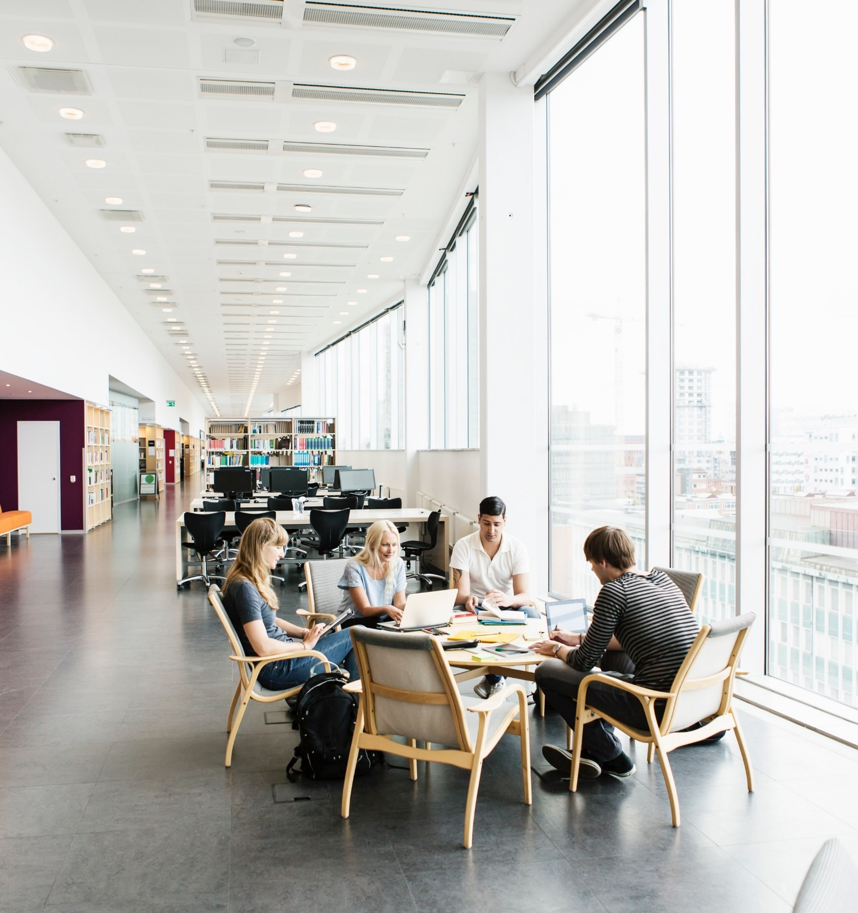
Introduction
SG Spray Tech Established in 2015 , a business is engaged in Paint Technology consultancy , Innovation in Paint Application , Distributor of Nippon Paints .
50% is Possible 5% is Impossible

Slide 4
Meet The Presenter
A paint technologist having 32 years of Industrial experience in Home appliances, Automotive & Locomotive(Railways) painting Industries.
Six Sigma Black belt
Granted Patent for “Painting with Heated Nitrogen , Ionizer & Use of Ultrasonic” in 2022
Patent Filed for “Paint preparation with the help of ultrasonic.”
Patent In process for paint emulsions making machine.
50% is Possible 5% is Impossible

Slide 5
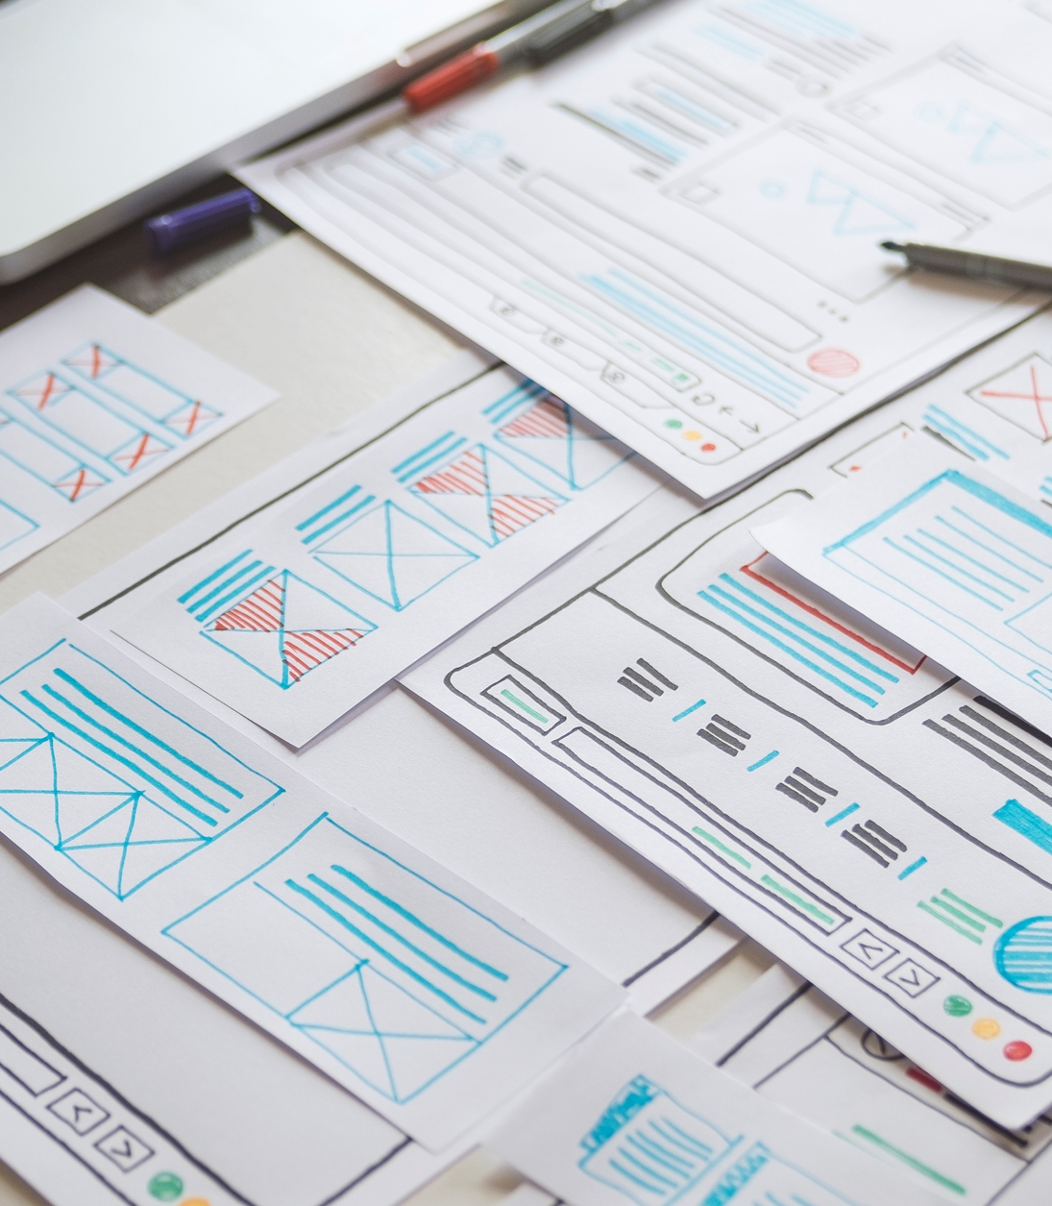
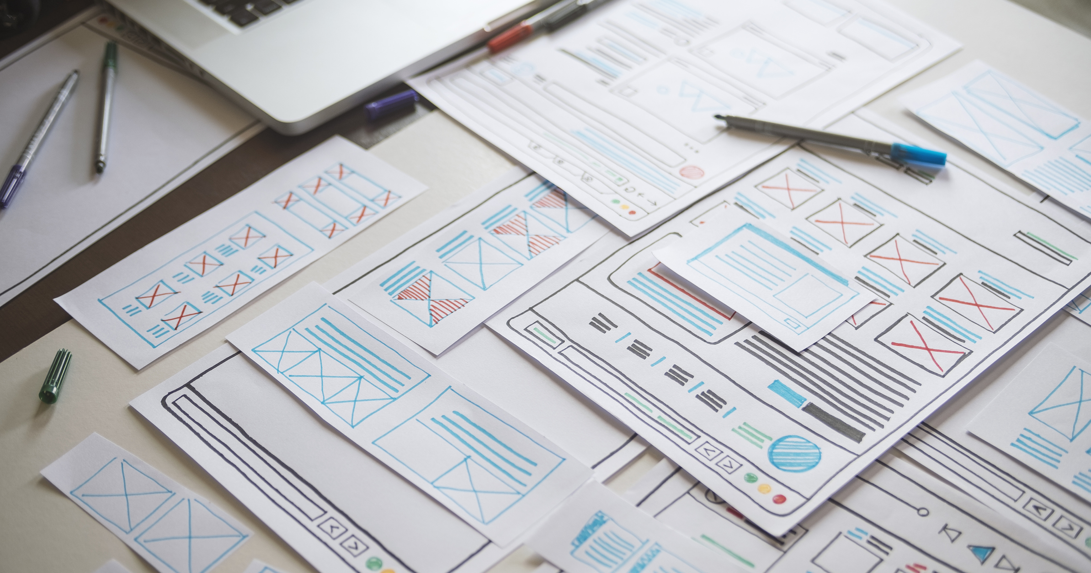
Expertise & Differentiators
Technical Expertise
Innovative Solutions
Industry Knowledge
Client-Centric Approach

Slide 6



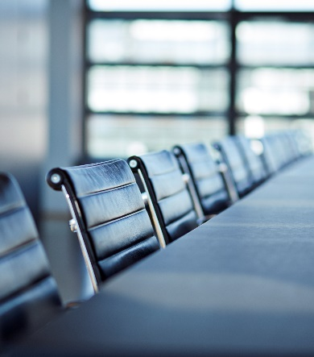
Our Approach By 4P’s
Problem
Process
Product
Pitch
Define the problem you aim to solve by DMAIC methodology
Process you followed to generate and evaluate Idea
Product or solution you developed
Value and Impact to your Customer
50% is Possible 5% is Impossible

Slide 7
Plan for Problem Solving
Define
Measure
Analyze
Improve
Control
Launch Team
Establish Charter
Plan Project
Gather the Voice of Customer
Plan for Change
Document the process
Collect Baseline Data
Narrow project focus
Analyze Data
Identify root cause
Identify and remove wastes
Generate Solutions
Evaluate Solutions
Optimize Solutions
Plan and implement
Control the process
Validate the Project benefits
50% is Possible 5% is Impossible

Slide 8
Success Stories
Client Name- Bright Autoplast, Chennai
Description - Rejection Reduction and Costing improvisation for Plastic painted Automotive parts. End customer Ford.
Outcome- profit margin hike from -4 % to 11%
Client Name- Ankita Auto Coaters, Pune
Description - Rejection Reduction and Costing improvisation, Implementation of POKAYOKE for Plastic painted Automotive parts. End customer Mahindra, Tata , Volkswagen.
Outcome- profit margin hike from 8 % to 25%
50% is Possible 5% is Impossible

Slide 9

Research & Innovation
Painting with Heated Nitrogen , Ionizer & Use of Ultrasonic Technology
USP
Viscosity reduction in paint.
Less thinner consumption reduction in VOC
Overspray reduction in waste control of paint
High DFT in single Coat
High DOI
Gloss improvement
Clean Environment
Less Orange Peel
Exhaust filter Glugging and Efficiency of filter increases
Production efficiency increases
Drying time between two coats reduces by which we can design a paint shop in a very small space.
Two important variables in painting i.e. temperature and humidity controls hence in all seasons we achieve same finish.

Slide 10

Areas of focus
Rejection Reduction
Cost Optimization
Current State Analysis:
Waste Identification
Waste Reduction Strategies
Best Practices
Revisiting current cost scenario
Cost-Benefit Analysis

Slide 11



How we get there
Gemba visit
Process Optimization
VSM Project
New Paint Technology Implementation
Shop Floor Trainings

Slide 12


Q & A Open the Floor for Questions

Slide 13



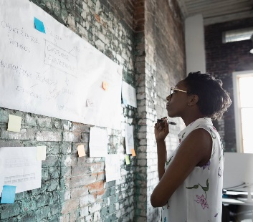
Thank you
Mr. Rajesh Gawde
rsohamgawde@yahoo.co.in
7350566121

